Slide 1
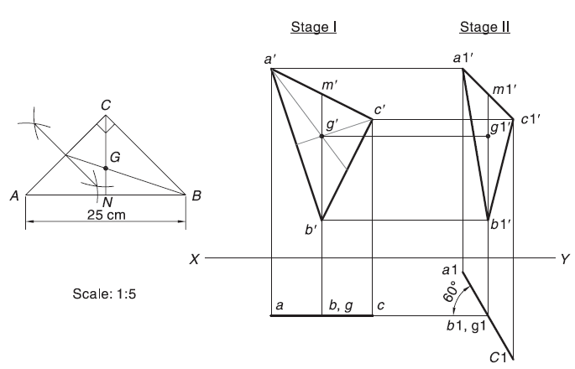
Suspended Planes
A 45° set square, having longest side as 25 cm, is freely suspended from the midpoint of one of the shorter sides. The plane of the set square makes 60° with a vertical wall. Draw the two views of the set square.

Slide 2
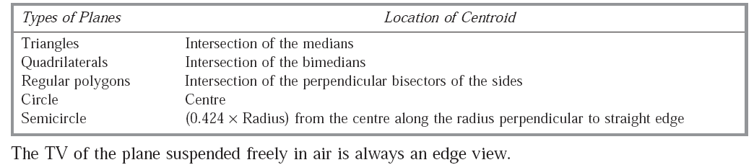

Slide 3
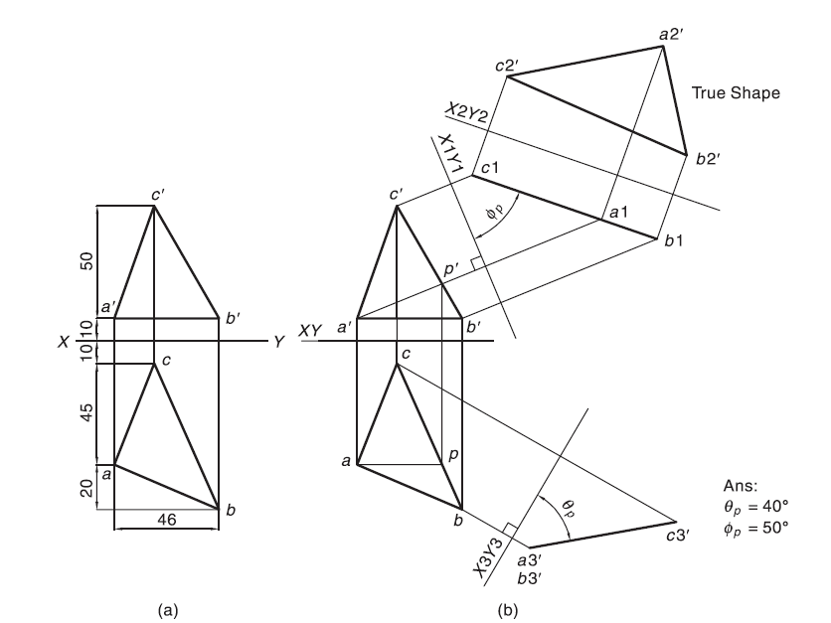
True shape of the plane

Slide 4
